Slide 1
Chapter 3 Selections
Liang, Introduction to Java Programming, Tenth Edition, (c) 2015 Pearson Education, Inc. All rights reserved.

Slide 2
Motivations
If you assigned a negative value for radius in Listing 2.2, ComputeAreaWithConsoleInput.java, the program would print an invalid result. If the radius is negative, you don't want the program to compute the area. How can you deal with this situation?

Slide 3
The boolean Type and Operators
Often in a program you need to compare two values, such as whether i is greater than j. Java provides six comparison operators (also known as relational operators) that can be used to compare two values. The result of the comparison is a Boolean value: true or false.
boolean b = (1 > 2);

Slide 4
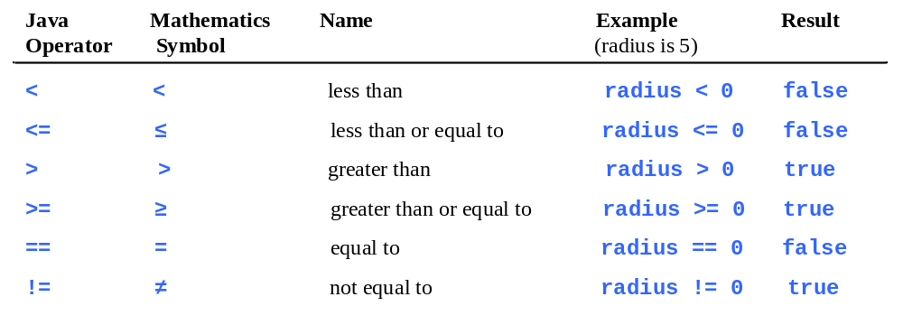
Relational Operators

Slide 5
Problem: A Simple Math Learning Tool
This example creates a program to let a first grader practice additions. The program randomly generates two single-digit integers number1 and number2 and displays a question such as “What is 7 + 9?” to the student. After the student types the answer, the program displays a message to indicate whether the answer is true or false.
IMPORTANT NOTE: If you cannot run the buttons, see www.cs.armstrong.edu/liang/javaslidenote.doc.
AdditionQuiz
Run

Slide 6
AdditonQuiz.java
Listing 3.1 on page 79

Slide 7
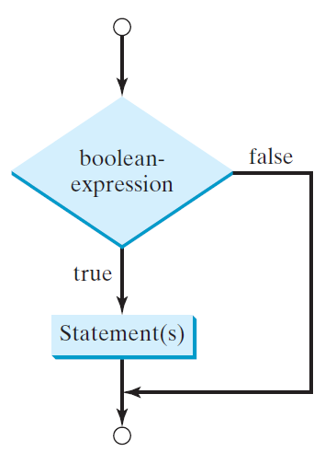
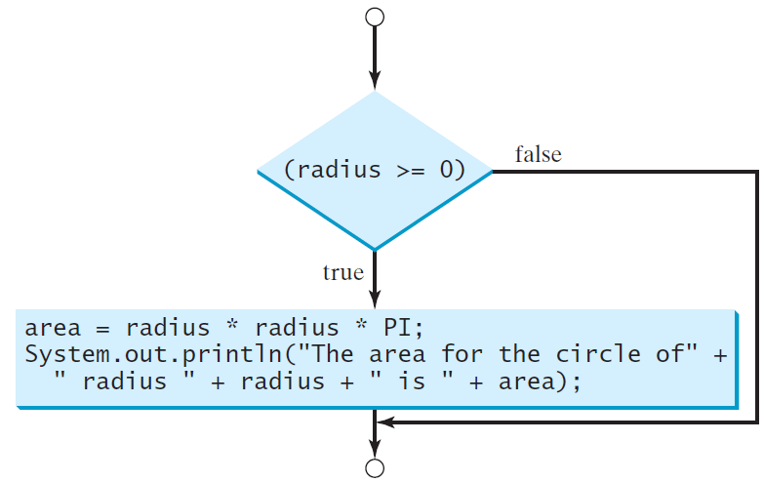
One-way if Statements
if (radius >= 0) {
area = radius * radius * PI;
System.out.println("The area"
+ " for the circle of radius "
+ radius + " is " + area);
}
if (boolean-expression) {
statement(s);
}

Slide 8


Note

Slide 9
Simple if Demo
Write a program that prompts the user to enter an integer. If the number is a multiple of 5, print HiFive. If the number is divisible by 2, print HiEven.
SimpleIfDemo
Run

Slide 10
SimpleIfDemo.java
Listing 3.2 on page 81

Slide 11
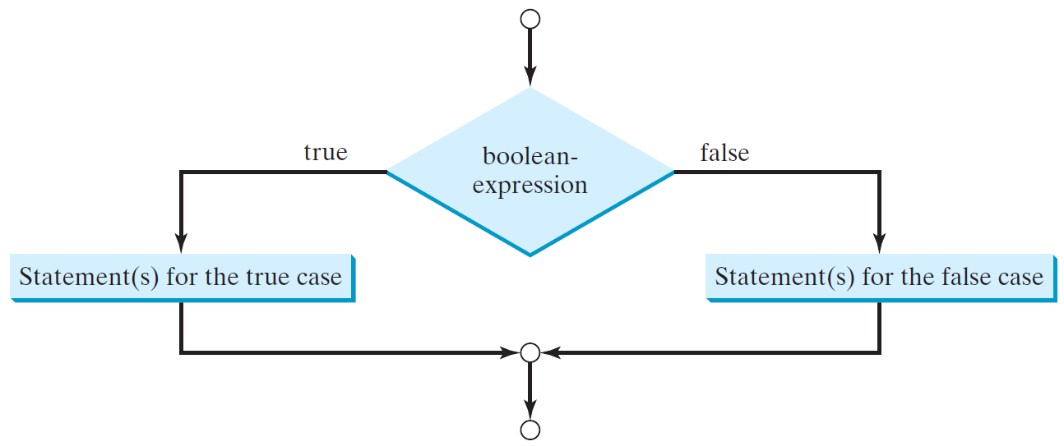
The Two-way if Statement
if (boolean-expression) {
statement(s)-for-the-true-case;
}
else {
statement(s)-for-the-false-case;
}

Slide 12
if-else Example
if (radius >= 0) {
area = radius * radius * 3.14159;
System.out.println("The area for the “
+ “circle of radius " + radius +
" is " + area);
}
else {
System.out.println("Negative input");
}

Slide 13
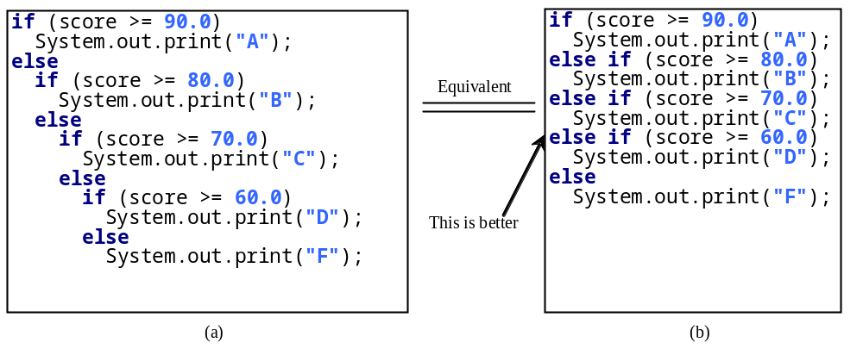
Multiple Alternative if Statements

Slide 14
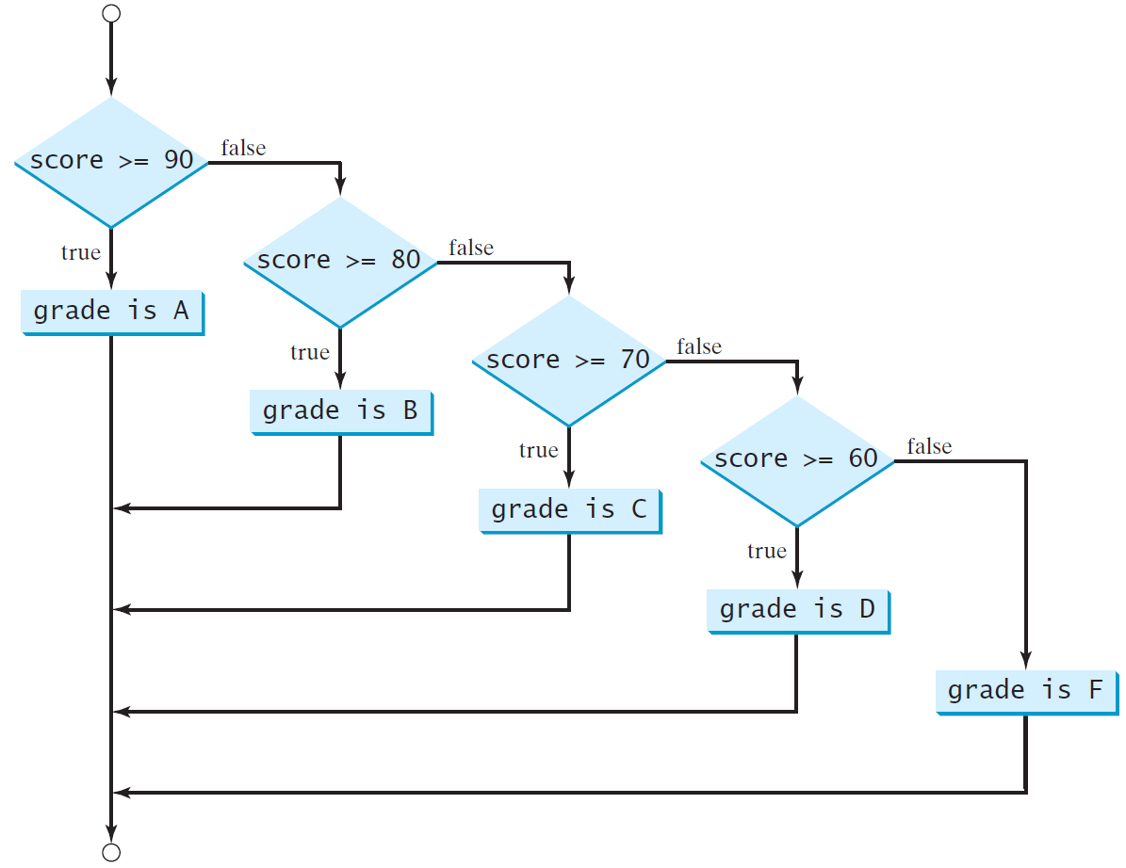
Multi-Way if-else Statements

Slide 15
Trace if-else statement
animation
Suppose score is 70.0
The condition is false
if (score >= 90.0)
System.out.print("A");
else if (score >= 80.0)
System.out.print("B");
else if (score >= 70.0)
System.out.print("C");
else if (score >= 60.0)
System.out.print("D");
else
System.out.print("F");

Slide 16
Trace if-else statement
animation
Suppose score is 70.0
The condition is false
if (score >= 90.0)
System.out.print("A");
else if (score >= 80.0)
System.out.print("B");
else if (score >= 70.0)
System.out.print("C");
else if (score >= 60.0)
System.out.print("D");
else
System.out.print("F");

Slide 17
Trace if-else statement
animation
Suppose score is 70.0
The condition is true
if (score >= 90.0)
System.out.print("A");
else if (score >= 80.0)
System.out.print("B");
else if (score >= 70.0)
System.out.print("C");
else if (score >= 60.0)
System.out.print("D");
else
System.out.print("F");

Slide 18
Trace if-else statement
animation
Suppose score is 70.0
grade is C
if (score >= 90.0)
System.out.print("A");
else if (score >= 80.0)
System.out.print("B");
else if (score >= 70.0)
System.out.print("C");
else if (score >= 60.0)
System.out.print("D");
else
System.out.print("F");

Slide 19
Trace if-else statement
animation
Suppose score is 70.0
Exit the if statement
if (score >= 90.0)
System.out.print("A");
else if (score >= 80.0)
System.out.print("B");
else if (score >= 70.0)
System.out.print("C");
else if (score >= 60.0)
System.out.print("D");
else
System.out.print("F");

Slide 20
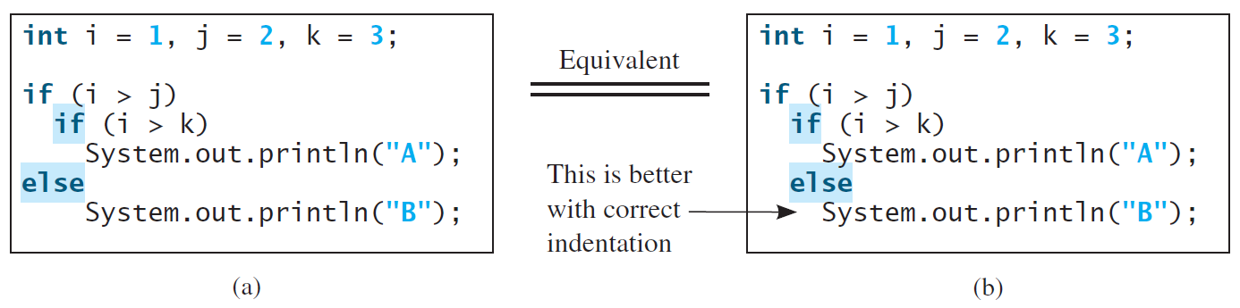
Note
The else clause matches the most recent if clause in the same block.

Slide 21
Note, cont.
Nothing is printed from the preceding statement. To force the else clause to match the first if clause, you must add a pair of braces:
int i = 1;
int j = 2;
int k = 3;
if (i > j) {
if (i > k)
System.out.println("A");
}
else
System.out.println("B");
This statement prints B.

Slide 22
Common Errors
Adding a semicolon at the end of an if clause is a common mistake.
if (radius >= 0);
{
area = radius*radius*PI;
System.out.println(
"The area for the circle of radius " +
radius + " is " + area);
}
This mistake is hard to find, because it is not a compilation error or a runtime error, it is a logic error.
This error often occurs when you use the next-line block style.
Wrong

Slide 23

TIP

Slide 24

CAUTION

Slide 25
Problem: An Improved Math Learning Tool
This example creates a program to teach a first grade child how to learn subtractions. The program randomly generates two single-digit integers number1 and number2 with number1 >= number2 and displays a question such as “What is 9 – 2?” to the student. After the student types the answer, the program displays whether the answer is correct.
SubtractionQuiz
Run

Slide 26
SubtractionQuiz.java
Listing 3.3 on pages 88-89

